Slide 1
Sixways Stadium
Taking conferences and events to another level

Slide 2
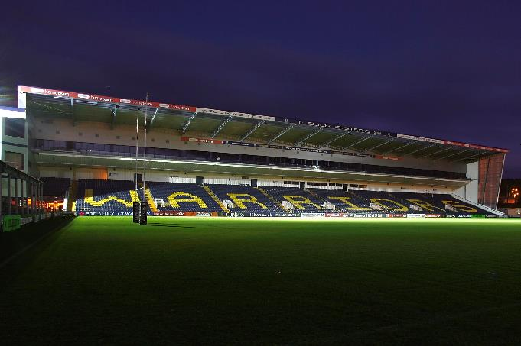

Slide 3
Prime Location
Sixways Stadium a 65 acre complex
Situated centrally in the Midlands we are within striking distance of the M5 with fantastic transport links
Free wifi throughout
57 Conference & Banqueting Suites holding any number of guests from 1 to 650
More than 1,000 onsite car parking spaces

Slide 4
Sixways Events
Product Launches
Seminars
Award Ceremonies
Exhibitions
Training Events
Gala Dinner Dances
Weddings
www.sixwaysevents.co.uk
Events@warriors.co.uk
Conference Desk: 01905 459 322
Corporate Days
Meetings
Sales Conferences
Concerts
Parties
Prestigious Events
Team Building

Slide 5
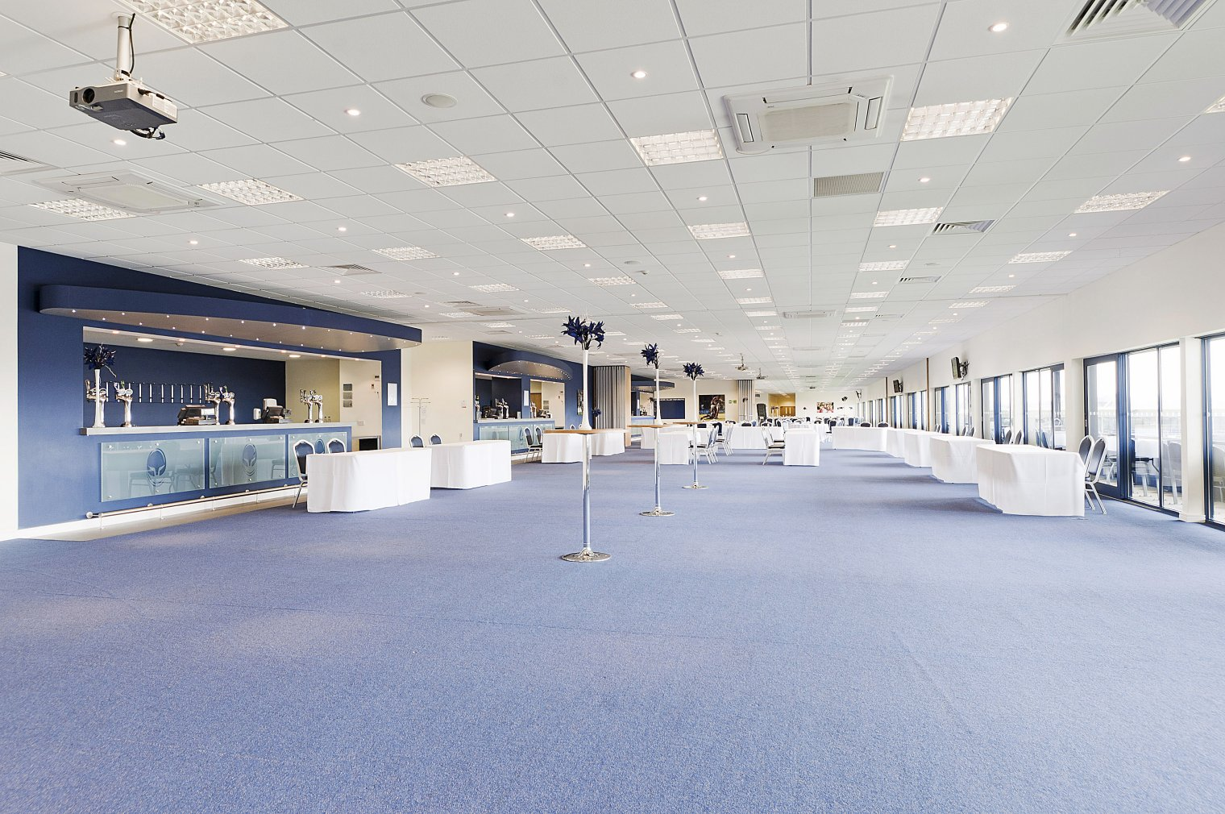
East Stand - Pitchview

Slide 6
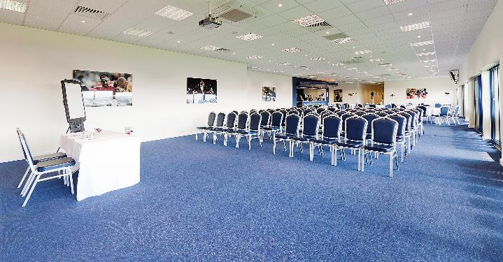
Duckworth Suite

Slide 7
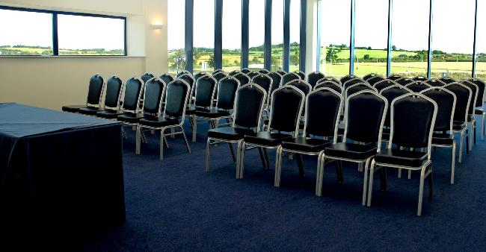
Hindlip Suite

Slide 8
Sixways Stadium location map

